Slide 1
Spring AOP
Authored by : Ankita Barwad Presented by : Ankita Barwad
Purnima Tripathi Purnima Tripathi

Slide 2
Agenda
What is AOP?
Why to use AOP?
AOP Terminologies
AOP Implementations
Demo

Slide 3
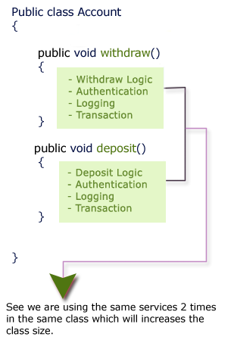
What is AOP?
Aspect-Oriented Programming (AOP) complements Object-Oriented Programming (OOP) by providing another way of thinking about program structure. For instance…

Slide 4
The key unit of modularity in OOP is the class, whereas in AOP the unit of modularity is the aspect.
Aspects enable the modularization of concerns such as transaction management that cut across multiple types and objects.
Entails breaking down program logic into distinct parts called so-called concerns.

Slide 5
Why to use AOP?
AOP is used in the Spring Framework to…
provide declarative enterprise services, especially as a replacement for EJB declarative services. The most important such service is declarative transaction management.
allow users to implement custom aspects, complementing their use of OOP with AOP.

Slide 6
It provides the pluggable way to dynamically add the additional concern before, after or around the actual logic. Suppose there are 10 methods in a class as given below:
class A{
public void m1(){...}
public void m2(){...}
public void m3(){...}
public void m4(){...}
public void m5(){...}
public void n1(){...}
public void n2(){...}
public void p1(){...}
public void p2(){...}
public void p3(){...}
}

Slide 7
AOP Terminologies
Aspect
Advice
Pointcut
AOP Proxy
Join Point
Introduction
Target Object
Weaving
Interceptor

Slide 8
Aspect
An aspect represent the cross-cutting functionality name, remember just name only.
One real time service required for a business logic is called one Aspect.
Aspect denotes only the cross-cutting functionality name not its implementation and all.

Slide 10
Any Questions?

Slide 11
Thank you!

